Slide 1
CS60010: Deep Learning
Sudeshna Sarkar
Spring 2019

Slide 2
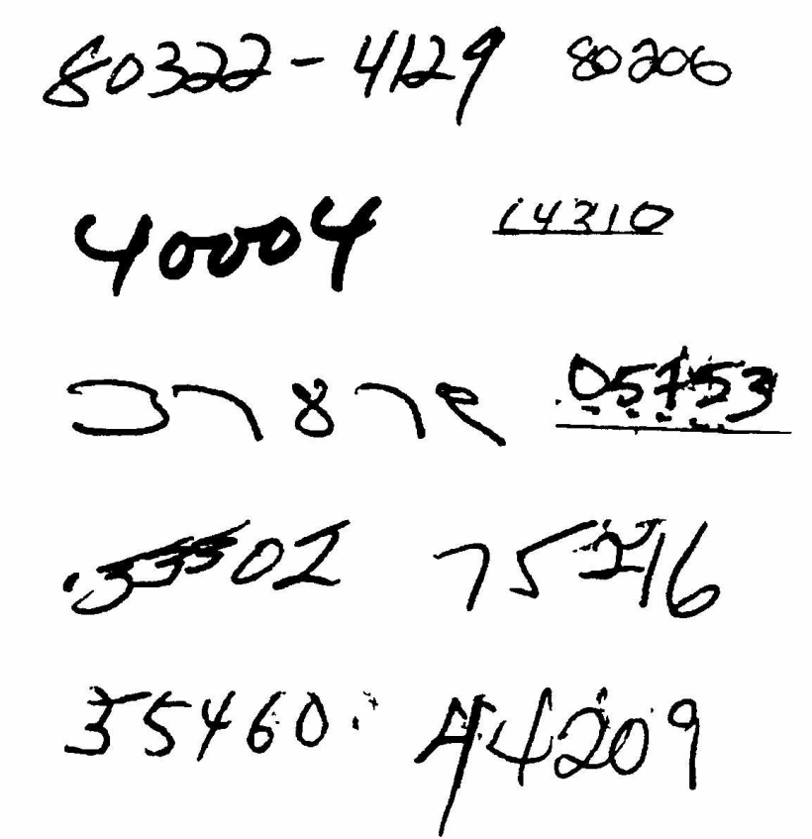
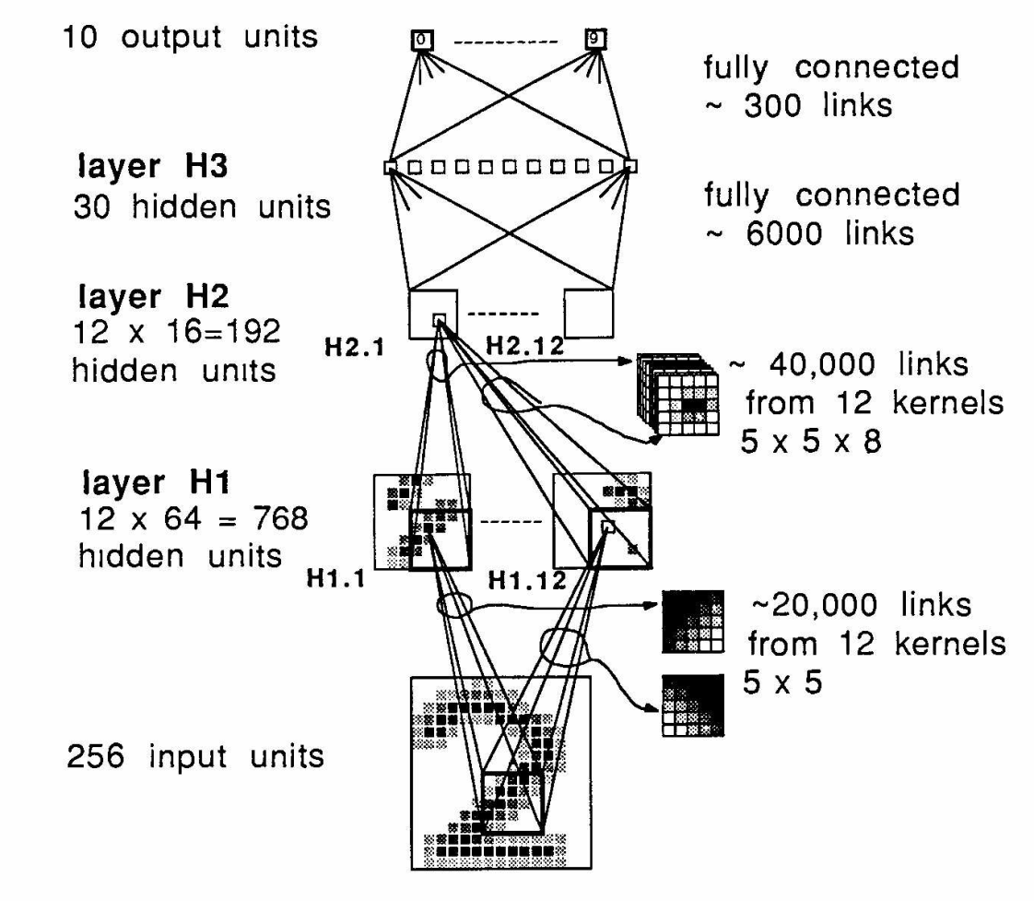
Milestones: Digit Recognition
LeNet 1989: recognize zip codes, Yann Lecun, Bernhard Boser and others, ran live in US postal service
Notes:
Around 5% error rate. Good enough to be useful.

Slide 3
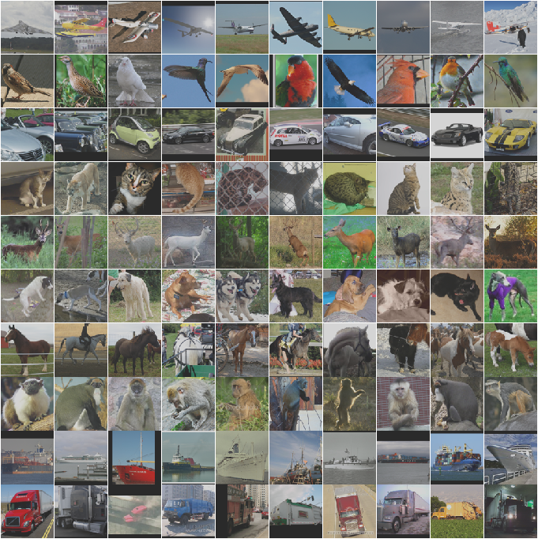
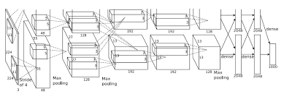
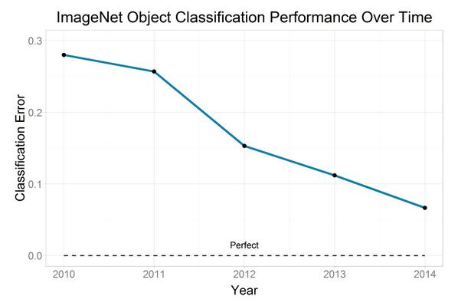
Milestones: Image Classification
Convolutional NNs: AlexNet (2012): trained on 200 GB of ImageNet Data
Human performance 5.1% error

Slide 4
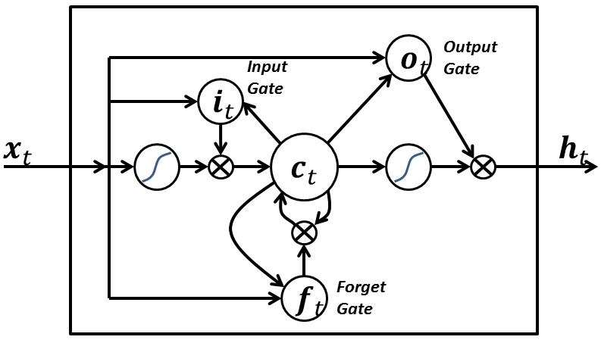
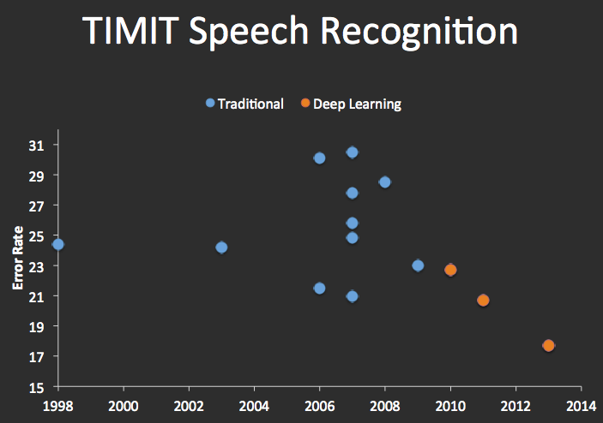
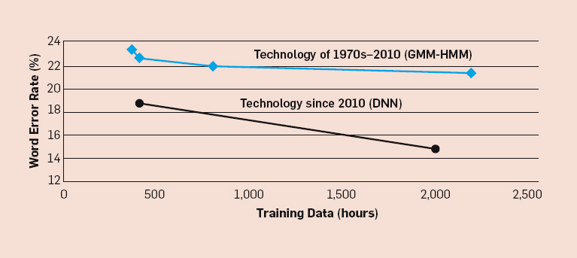
Milestones: Speech Recognition
Recurrent Nets: LSTMs (1997):

Slide 5
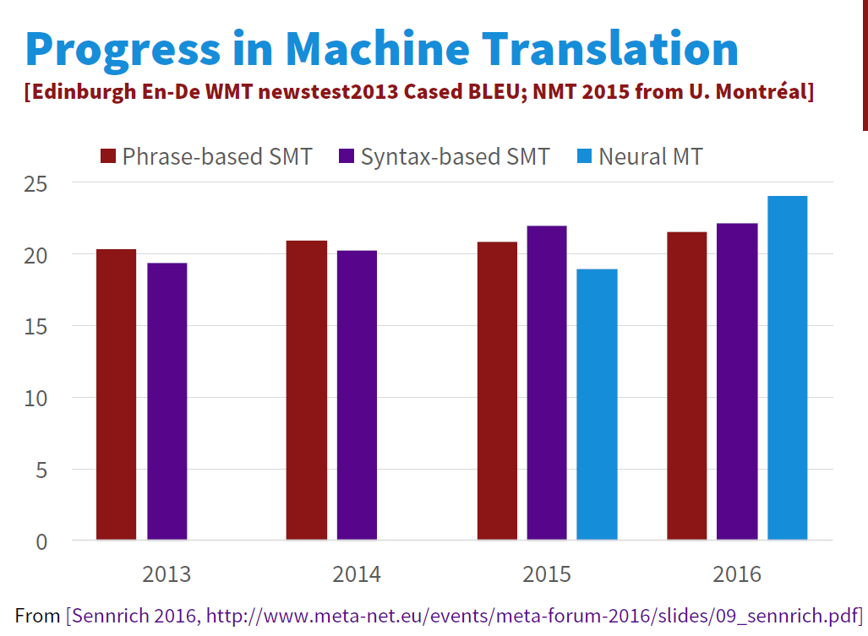
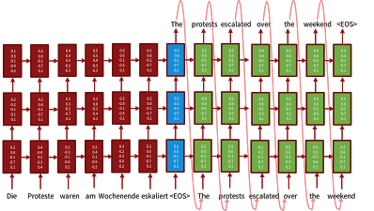
Milestones: Language Translation
Sequence-to-sequence models with LSTMs and attention:
Source Luong, Cho, Manning ACL Tutorial 2016.

Slide 6
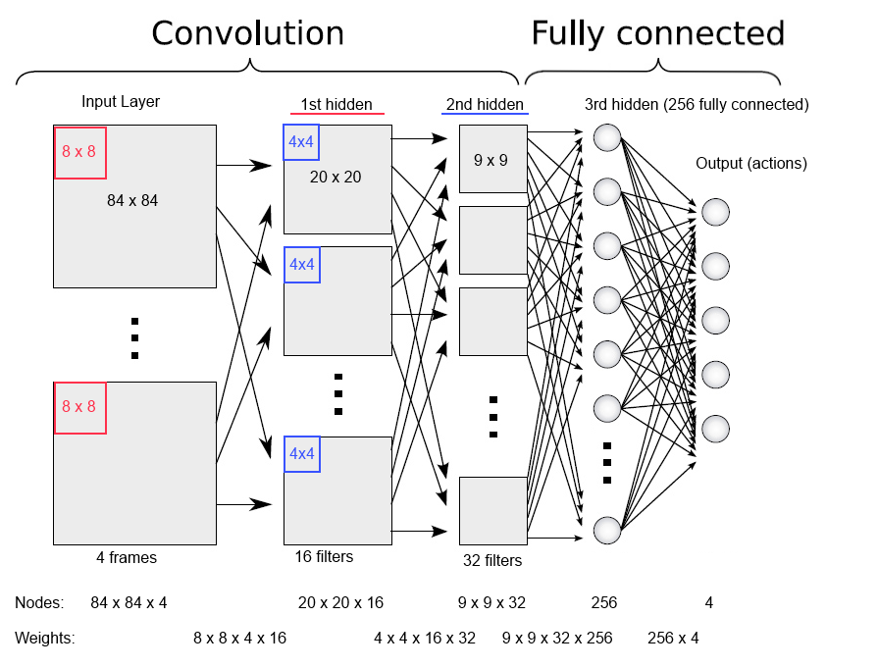
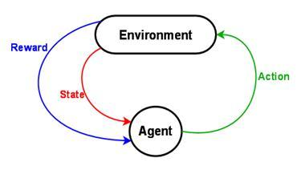
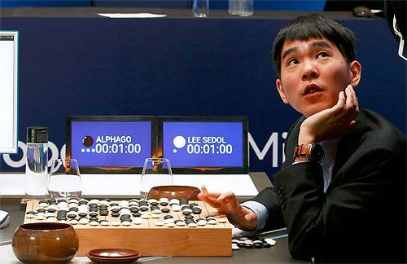
Milestones: Deep Reinforcement Learning
In 2013, Deep Mind’s arcade player bests human expert on six Atari Games. Acquired by Google in 2014,.
In 2016, Deep Mind’s
alphaGo defeats former world champion Lee Sedol
Notes:
Founders: Demis Hassabis, Shane Legg, Mustafa Suleyman
Why was this milestone particularly worrying from an ethics point of view?

Slide 7
Learning about Deep Neural Networks
Yann Lecun: DNNs require: “an interplay between intuitive insights, theoretical modeling, practical implementations, empirical studies, and scientific analyses”
i.e. there isn’t a framework or core set of principles to explain everything (c.f. graphical models for machine learning).

Slide 8
This Course
Goals:
Introduce deep learning.
Review principles and techniques for understanding deep networks.
Develop skill at designing networks for applications

Slide 9
This Course
Attendance: 5%
Quizzes: 5%
Assignments : 20%
Midterm: 30%
Endterm: 40%
TAs:
Moodle
Course Home Page

Slide 10
Prerequisites
Knowledge of calculus and linear algebra
Probability and Statistics
Machine Learning
Programming in Python.

Slide 11
Phases of Neural Network Research
1940s-1960s: Cybernetics: Brain like electronic systems, morphed into modern control theory and signal processing.
1960s-1980s: Digital computers, automata theory, computational complexity theory: simple shallow circuits are very limited…
1980s-1990s: Connectionism: complex, non-linear networks, back-propagation.
1990s-2010s: Computational learning theory, graphical models: Learning is computationally hard, simple shallow circuits are very limited…
2006→: Deep learning: End-to-end training, large datasets, explosion in applications.

Slide 12
The success of NN
More data
More computational power
Improved techniques (though they’re not brand-new)
But, Driven primarily by intuition and empirical success
Good research and progress based on solid intuition
Practice leads the way
Theory lags dramatically
no guarantees
little understanding of limitations
limited interpretability
More interestingly, classic theory suggests currently successful DL practices, wouldn’t be likely to succeed.

Slide 13


Citations of the “LeNet” paper
Recall the LeNet was a modern visual classification network that recognized digits for zip codes. Its citations look like this:
The 2000s were a golden age for machine learning, and marked the ascent of graphical models. But not so for neural networks.
Second phase
Deep Learning “Winter”
Third phase

Slide 14
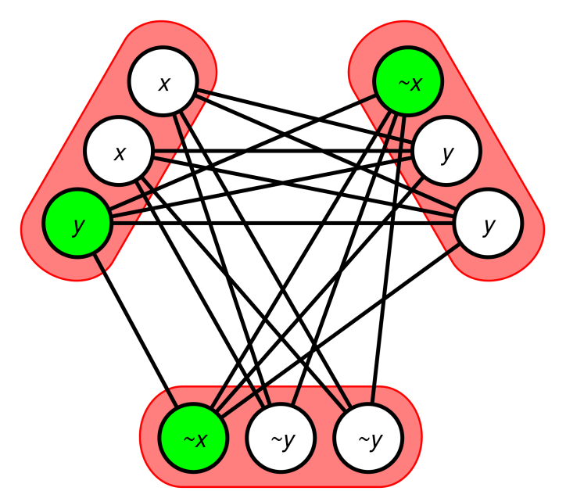
Why the success of DNNs is surprising
From both complexity and learning theory perspectives, simple networks are very limited.
Can’t compute parity with a small network.
NP-Hard to learn “simple” functions like 3SAT formulae, and i.e. training a DNN is NP-hard.

Slide 15
Why the success of DNNs is surprising
The most successful DNN training algorithm is a version of gradient descent which will only find local optima. In other words, it’s a greedy algorithm. Backprop:
loss = f(g(h(y)))
d loss/dy = f’(g) x g’(h) x h’(y)
Greedy algorithms are even more limited in what they can represent and how well they learn.
If a problem has a greedy solution, its regarded as an “easy” problem.

Slide 16
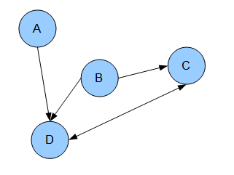
Why the success of DNNs is surprising
In graphical models, values in a network represent random variables, and have a clear meaning. The network structure encodes dependency information, i.e. you can represent rich models.
In a DNN, node activations encode nothing in particular, and the network structure only encodes (trivially) how they derive from each other.

Slide 17
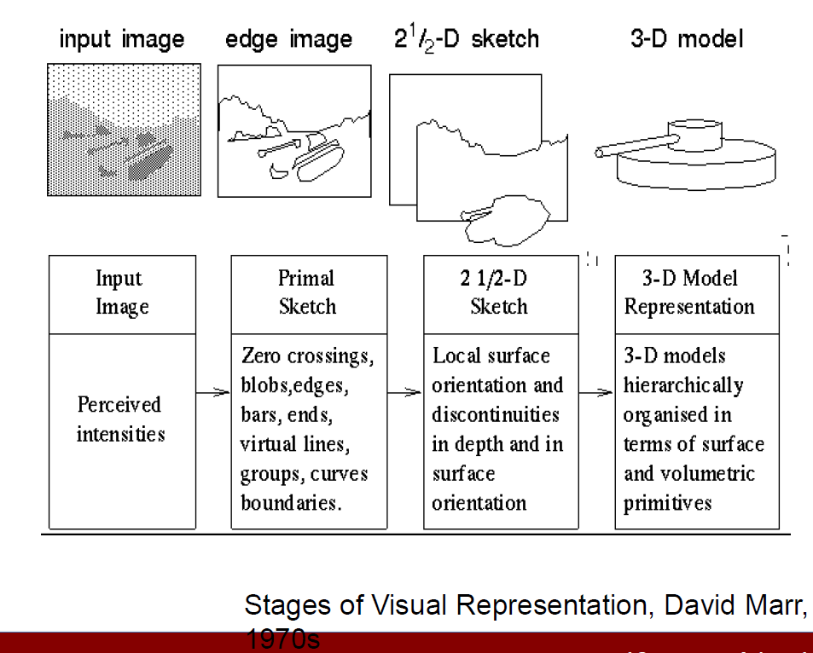
Why the success of DNNs is surprising obvious
Hierarchical representations are ubiquitous in AI. Computer vision:

Slide 18
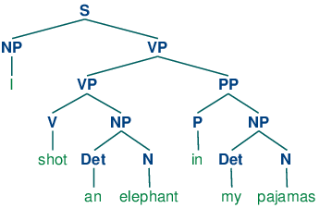
Why the success of DNNs is surprising obvious
Natural language:

Slide 19
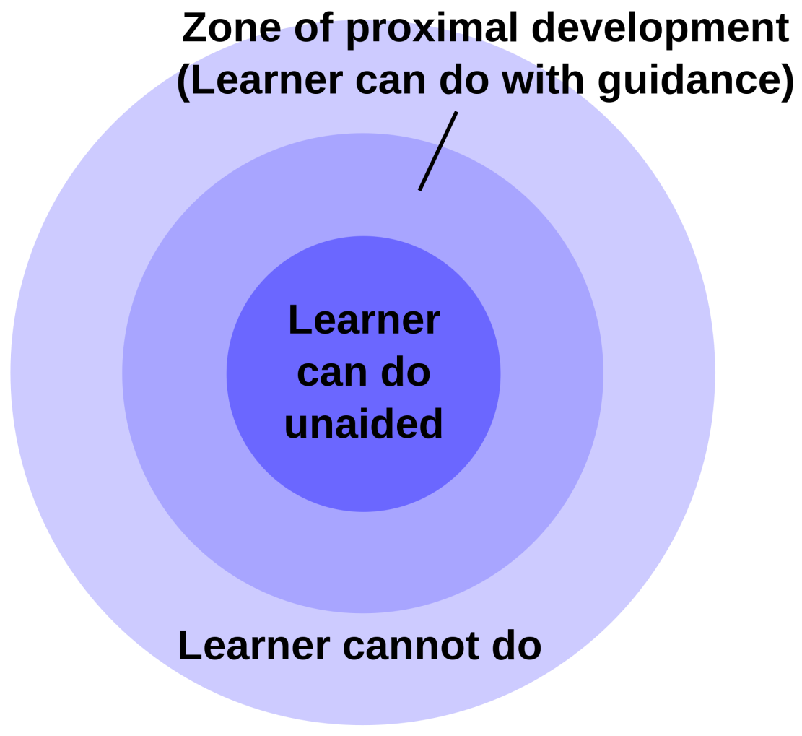
Why the success of DNNs is surprising obvious
Human Learning: is deeply layered.

Slide 20
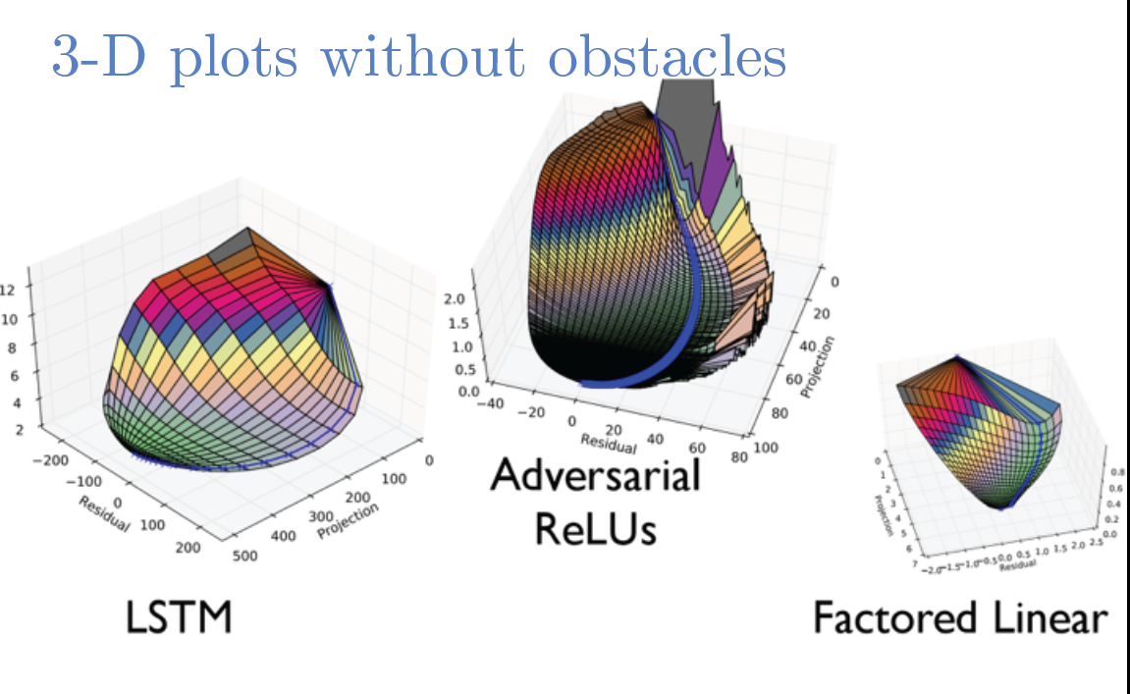
Why the success of DNNs is surprising obvious
What about greedy optimization?
Less obvious, but it looks like many learning problems (e.g. image classification) are actually “easy” i.e. have reliable steepest descent paths to a good model.
Ian Goodfellow – ICLR 2015 Tutorial

Slide 21
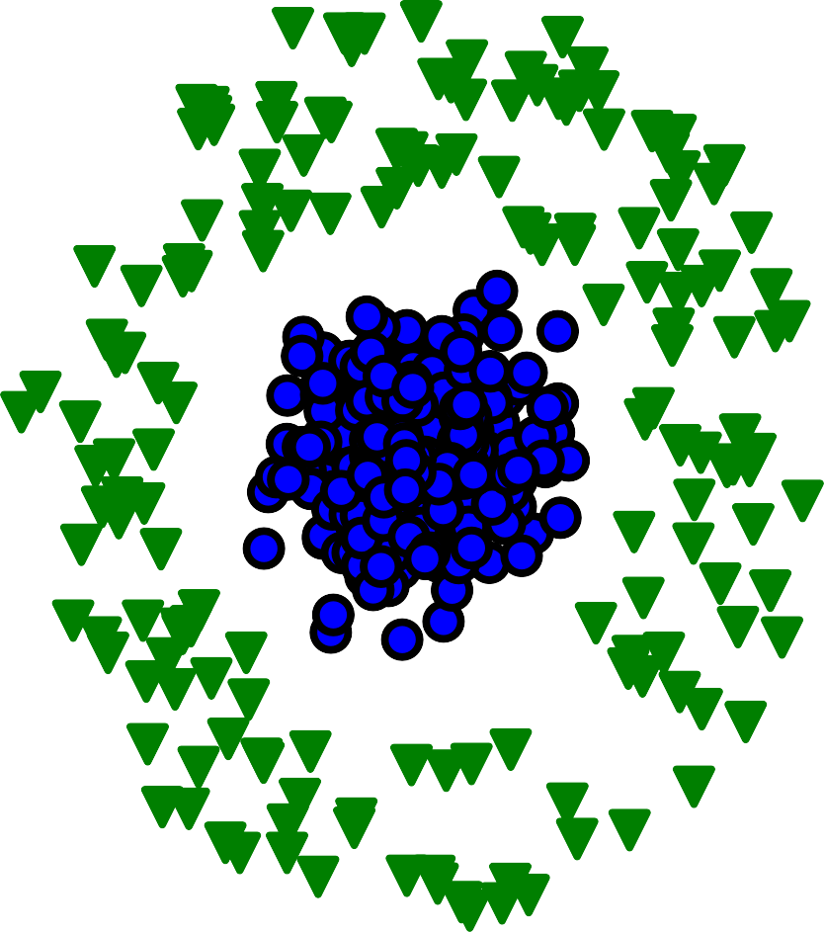
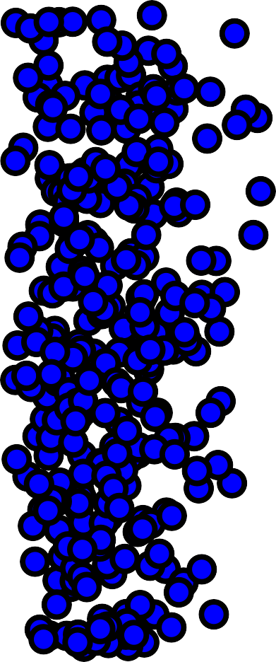
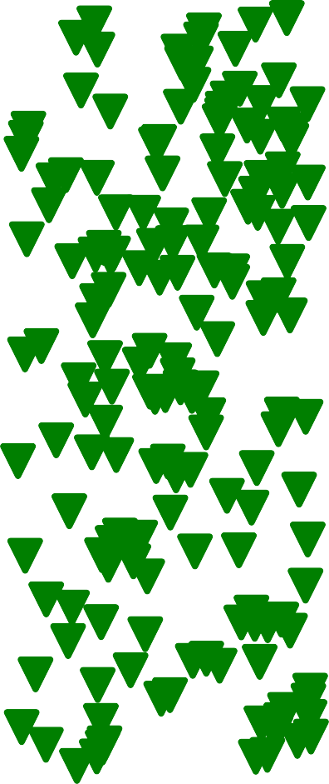
Representations Matter
Cartesian coordinates Polar coordinates
y
θ
x
r

Slide 22
Representation Learning
Use machine learning to discover not only the mapping from representation to output but also the representation itself.
Representation Learning
Learned representations often result in much better performance than can be obtained with hand-designed representations.
They also enable AI systems to rapidly adapt to new tasks, with minimal human intervention.

Slide 23

























Depth
CAR
PERSON
ANIMAL
Output (object identity)
3rd hidden layer (object parts)
2nd hidden layer (corners and contours)
1st hidden layer (edges)
Visible layer (input pixels)

Slide 24
Output
Output
Output
Mapping from features
Output
Mapping from features
Mapping from features
Additional layers of more abstract features
Hand- designed program
Hand- designed features
Features
Simple features
Input
Input
Input
Input
Classic machine learning
Deep learning
Rule-based systems
Representation learning

